Slide 1
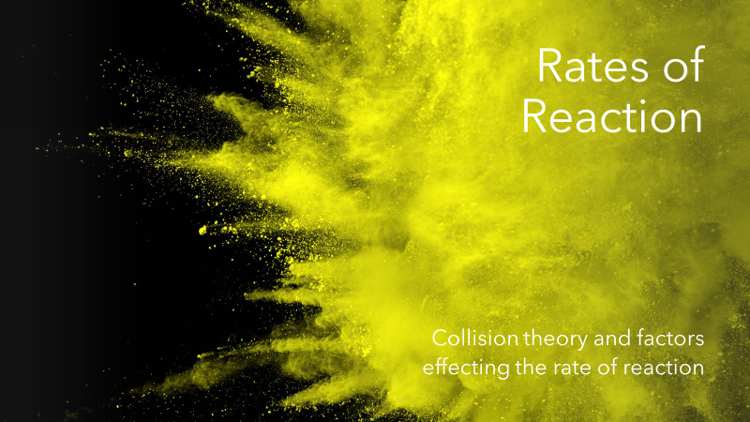
ATAR Chemistry Unit 3 2021

Slide 2
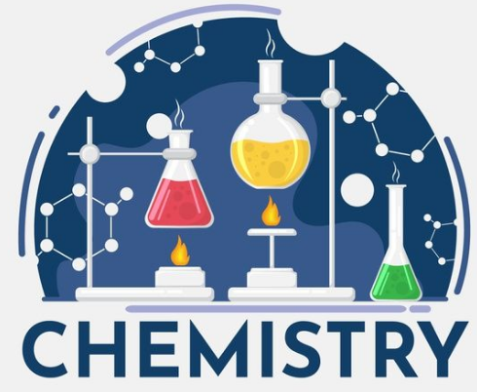
Outline
Review – Reaction rates
Collision theory
Activation energy and energy profile diagrams
Factors that affect rate of reaction
Ways to measure rates of reaction (including graphing results)
Resources
Essential chemistry unit 3 & 4: Ch 1.4 to 1.5, Set 1 Q 5-11
STAWA 12: Set 4 – Reaction rates and energy, Experiment 1
Your year 11 resources

Slide 3
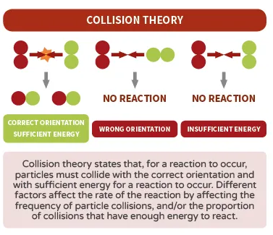
Collision theory
The way in which reactions occur can be understood in terms of collision theory
The reacting particles must collide
The particles must collide with enough energy to equal or exceed a certain amount (activation energy Ea)
Reacting particles must collide in a suitable orientation
All three of these must occur for a reaction to proceed
Picture: https://www.compoundchem.com/2016/02/17/rate-of-reaction/

Slide 4
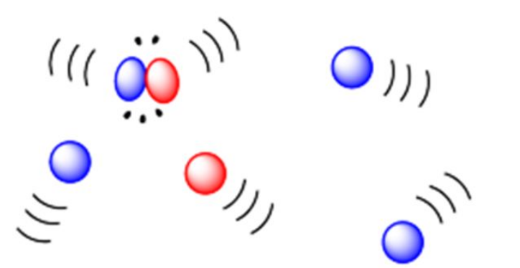
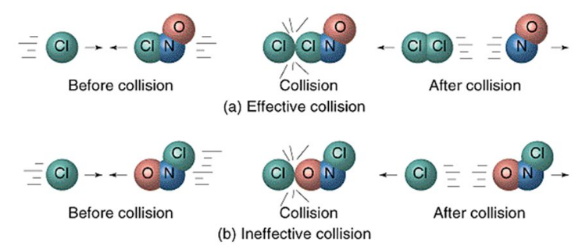
Collision theory
Must collide to react
Needs enough energy
Needs correct orientation

Slide 5
Activation energy
The minimum energy that colliding particles must have in order to react is called the activation energy.
You can think of the activation energy for a reaction as a barrier that reactants must cross before products can form.
As reacting particles approach each other, repulsive forces between electron clouds causes them to slow down and lose kinetic energy
This lost kinetic energy converts to increased potential energy of the colliding particles
If they have enough kinetic energy they will approach close enough (collide) to form a transition state also known as the activated complex – the highest potential energy state

Slide 6
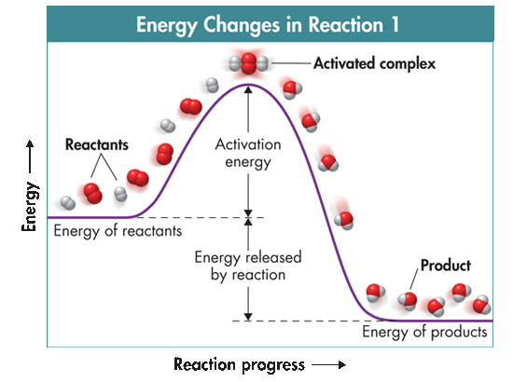
Activation energy
The activation-energy barrier must be crossed before reactants are converted to products.
Exothermic or endothermic?

Slide 7
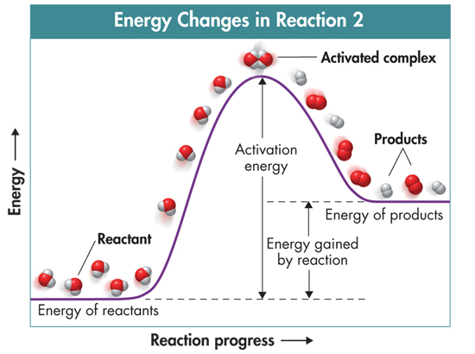
Activation energy
Exothermic
Endothermic

Slide 8
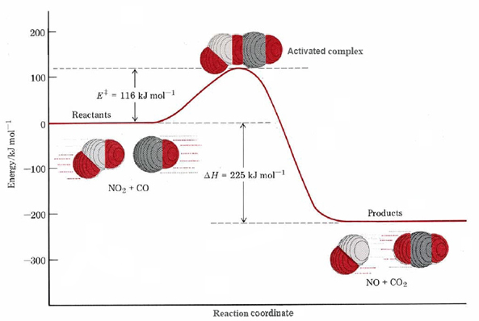
Activation energy
The transition state is where the original bonds are being broken and new bonds are being formed
It is an unstable arrangement; its brief existence ends with the reformation of the reactants or with the formation of products
The minimum collision energy required to form the transition state is known as the activation energy Ea

Slide 9
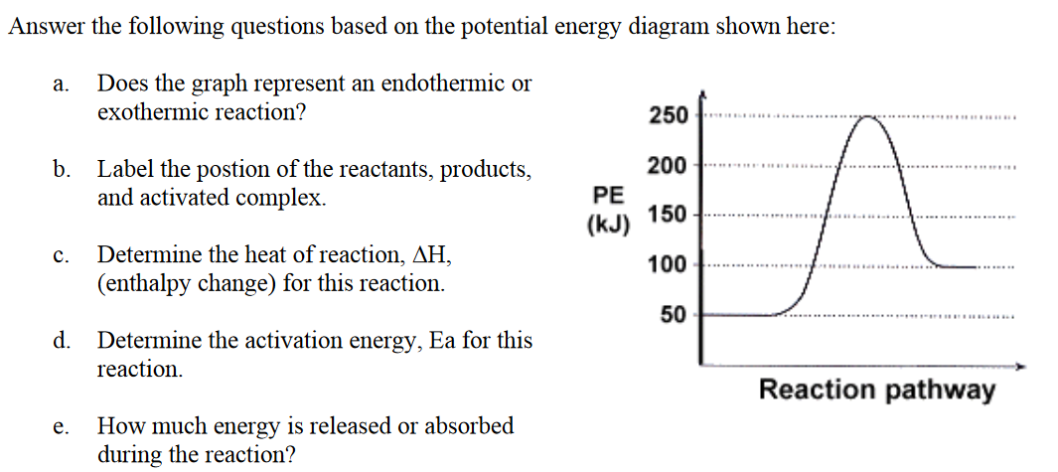
Activation energy
Check understanding

Slide 10
Activation energy
Transition state
Endothermic
products
∆H = + 50 kJ
∆H
reactants
Ea = 200 kJ
50 kJ of energy is absorbed in the reaction

Slide 11
Factors affecting rate
Keys Questions:
Does it increase the frequency of collisions?
Does it increase the percentage of successful collisions?
*All collision theory questions require an answer that clearly addresses both of these points*
Does the frequency of collisions change? This is how often the particles actually collide with each other (regardless of whether the collision is successful). E.g. if the frequency of collisions increases, the overall number of collisions increases which causes an increase in the rate of reaction
Does the percentage of successful collisions change? This is a discussion of how many collisions have sufficient energy to overcome Ea. E.g. if the particles have more kinetic energy, a higher percentage of collisions will be successful which cause an increase in the rate of reaction.

Slide 12
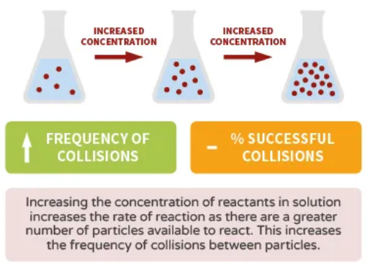
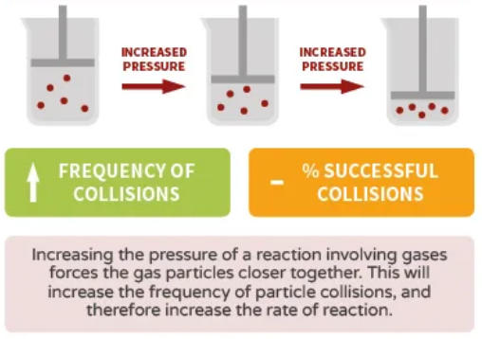
Factors affecting rate
Concentration and pressure
The number of particles in a fixed volume affects the rate at which reactions occur.
Cramming more particles into a fixed volume increases the concentration of reactants or increases the pressure, this increases the frequency of collision, with a larger overall number of collisions per minute the rate of the reaction increases
Reducing particles in a fixed volume (decreasing concentration or pressure), this reduces the frequency of collisions, so in a given space of time there will be less collisions and therefore the rate decreases.
Notes:
Note – the increase in pressure only increases the rate if the change occurs by decreasing the volume or adding in more of the reactant gases. If you add in a gas that is not part of the reaction, this will increase the pressure but it will not increase the rate of the reaction.

Slide 13
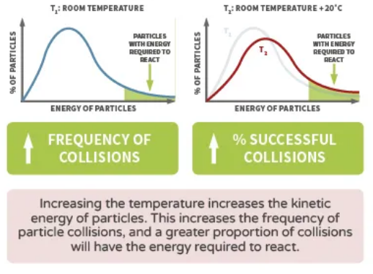
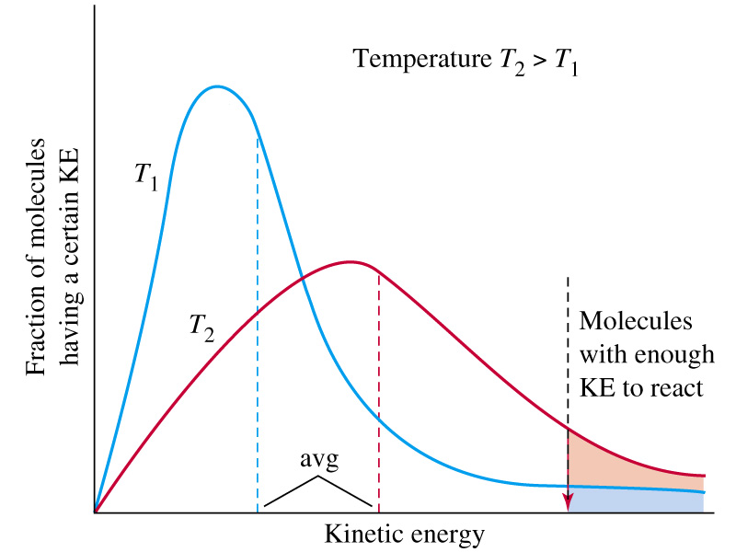
Factors affecting rate
Temperature
Increasing the temperature increases the reaction rate
At higher temperatures, particles on average have a greater kinetic energy and therefore a higher average speed.
This means that a higher percentage of collisions have energy equal to or greater than the activations energy
Greater percentage of collisions are successful, hence reaction rate increases
Two points – 1) higher av speed = higher frequency of collision and 2) – higher av kinetic energy = collisions with more force with higher percentage having sufficient energy to overcome Ea.
**You must discuss both**
You might get asked to draw a graph to demonstrate the point →

Slide 14
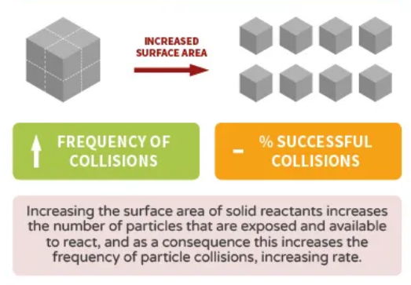
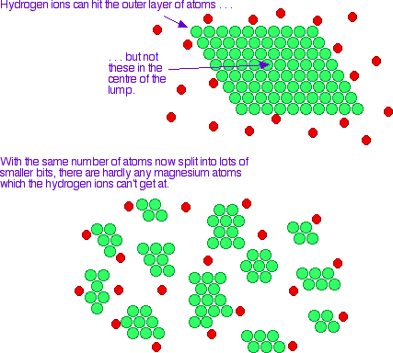
Factors affecting rate
Surface area
The total surface area of a solid or liquid reactant affects the rate of a reaction.
Reacting particles can only collide at surface boundaries where the phases make contact
Increasing the surface area exposes a greater amount of reacting particles to the possibility of collision
This results in increases frequency of collisions. (doesn’t change % successful)

Slide 15
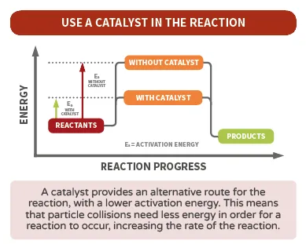
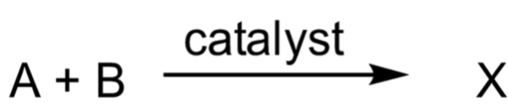
Factors affecting rate
Catalysts
Recall - Activation energy (Ea) is the minimum energy required for a reaction to take place
Catalysts are not consumed in the reaction (**So, we don’t write them in the equation. We write them above the reaction arrow**)
A catalysts increasing the rate of reaction by providing an alternative pathway for the reaction. The alternative path has a lower activation energy, so more particles now have sufficient kinetic energy to achieve a successful collision

Slide 16
Factors affecting rate
Catalysts cont.
A catalyst provides an alternative pathway for the reaction that has a lower activation energy (Ea). The result is that a greater proportion of particles now have sufficient kinetic energy to over come Ea leading to an increase in the percentage of successful collisions. This results in a higher frequency of successful collisions (greater number of successful collisions per unit of time) which is why the rate of reaction increases.

Slide 17
Factors affecting rate
Catalysts cont.
Activation
Energy
Activation energy (with catalyst)
Catalyst
added
Activation energy
Enthalpy
No. of particles
Reaction Co-ordinate
Energy of particles

Slide 18
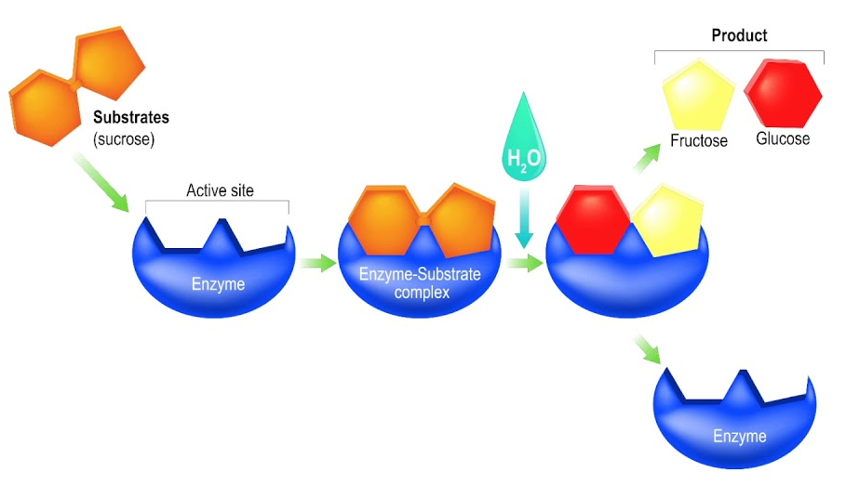
Factors affecting rate
Catalysts cont.
Examples of catalysts
Inorganic catalysts – e.g. many transition metals and compounds containing transition metals are good catalysts
The synthesis of ammonia (NH₃) from nitrogen gas (N₂) and hydrogen gas (H₂)
No catalyst – activation energy = 238.5 kJ/mol
With Catalyst – activation energy = 50.2 kJ/mol (used an iron catalysts)
Biological catalysts – enzymes catalyse many processing in living systems. These complex molecules have 3-dimensional structures that allow it to selective interact with specific substrates. Enzymes decrease Ea and direct the orientation of substrates.
Called the “LOCK and KEY” model

Slide 19
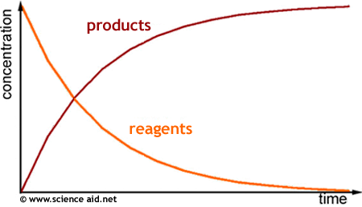
Measuring rate of reactions
Rate of reaction = amount of substance used or produced time taken
Can be measured in moles per second, grams per second litres per second
Shows the formation of products or the consumption of reactants

Slide 20
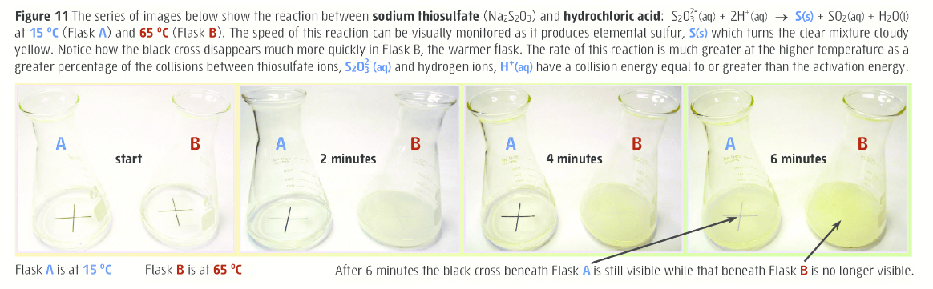
Measuring rate of reactions
1. Formation of a solid product (you did this experiment in year 11)

Slide 21
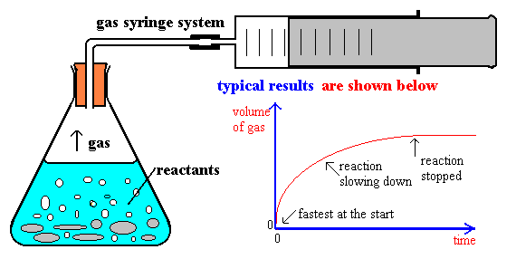
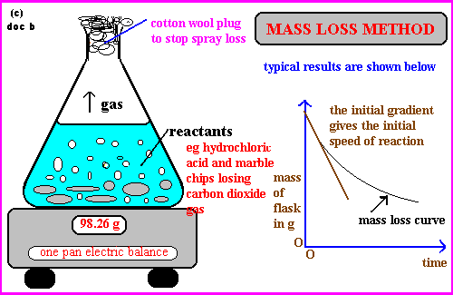

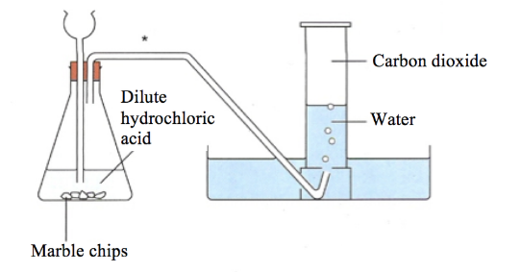
Measuring rate of reactions
2. Formation of a gaseous product (look at different graph shapes)
Method a) Collect the gas
Method b) Monitor change mass in open system

Slide 22
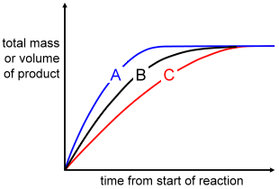

Measuring rate of reactions
A reaction rate is usually very fast at the start of a reaction as there are more reactants
As the reactants become consumed the reaction rate slows down
The steepness of the curve shows relative reaction rate, steeper = faster
The levelling out shows that the reaction has gone to completion
+
→

Slide 23
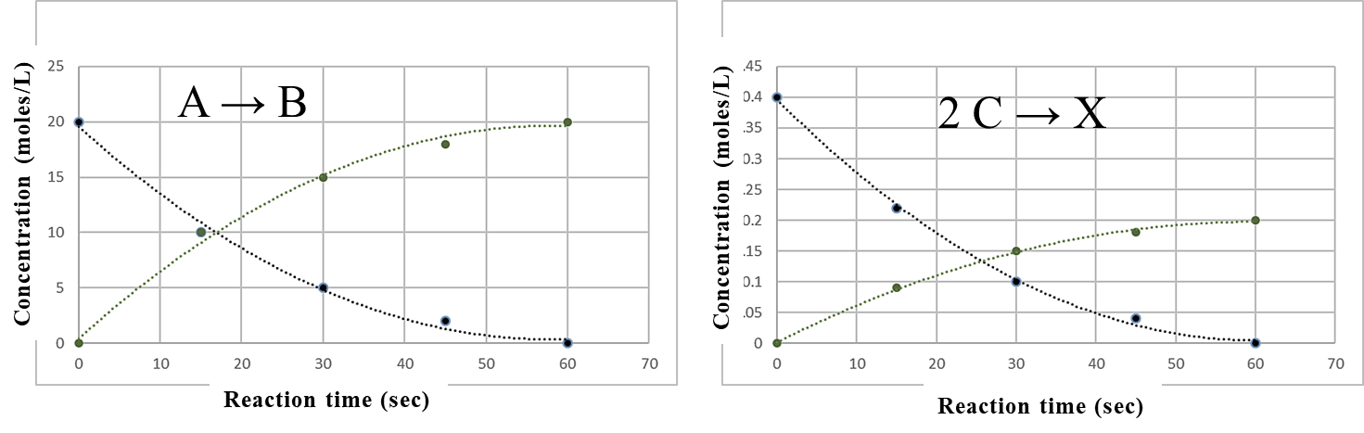
Measuring rate of reactions
Consider the graphs of concentration versus time for two reactions shown above. Look at the shape of the curves and compare to the reaction and the reaction coefficients.

